Slide 1
FullStack Project
Jeky (221510007)
Malvin (221510045)
Juventus (221510010)
Richard (221510048)

Slide 2
Your best quote that reflects your approach… “It’s one small step for man, one giant leap for mankind.”
- Neil Armstrong

Slide 3
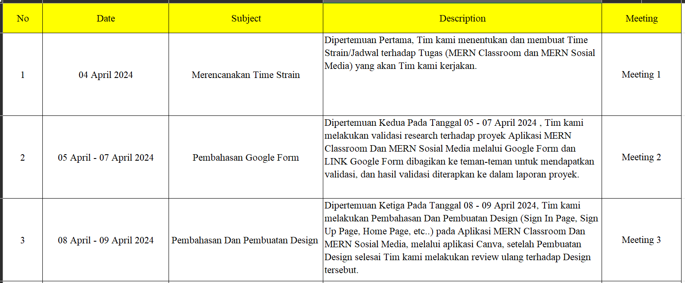

Slide 4
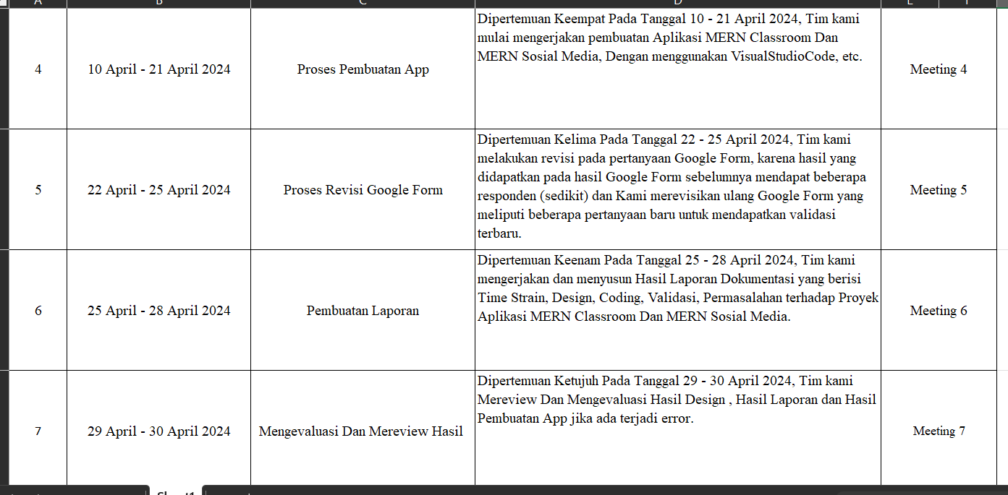

Slide 5
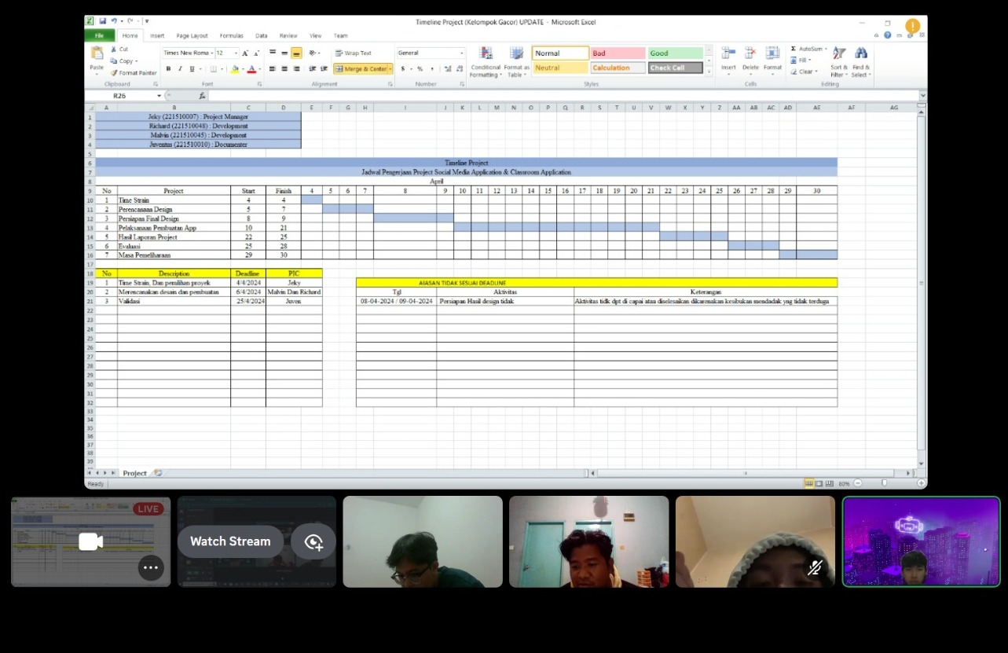
Hasil Laporan
Meeting 1 – Perencanaan Time Strain

Slide 6
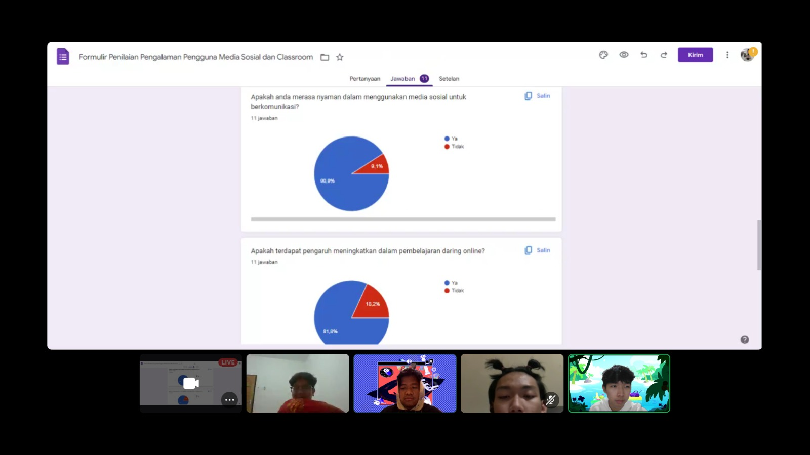
Hasil Laporan
Meeting 2 – Pembahasan Google Form

Slide 7
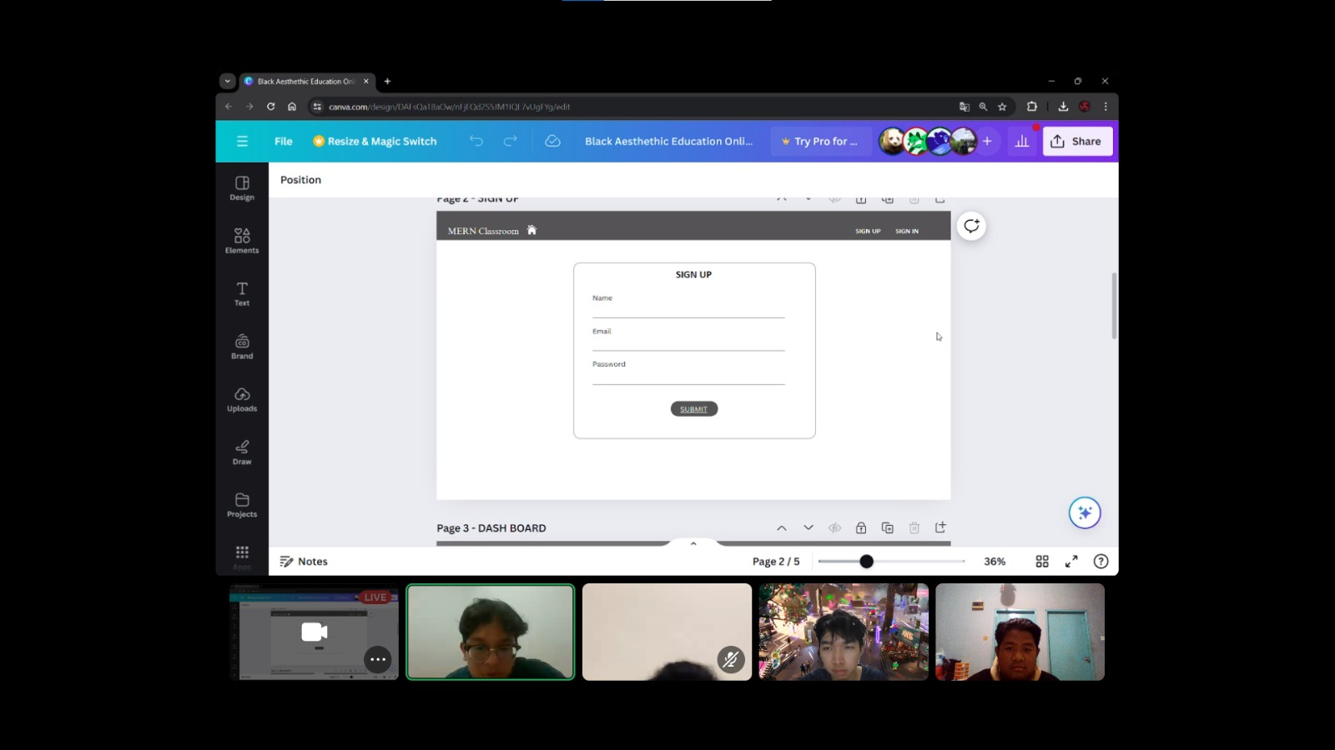
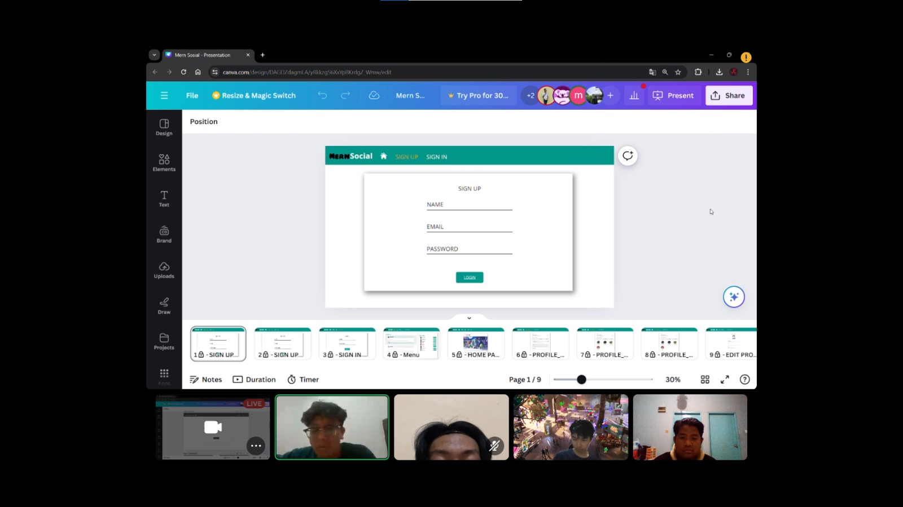
Hasil Laporan
Meeting 3 – Pembuatan Design

Slide 8
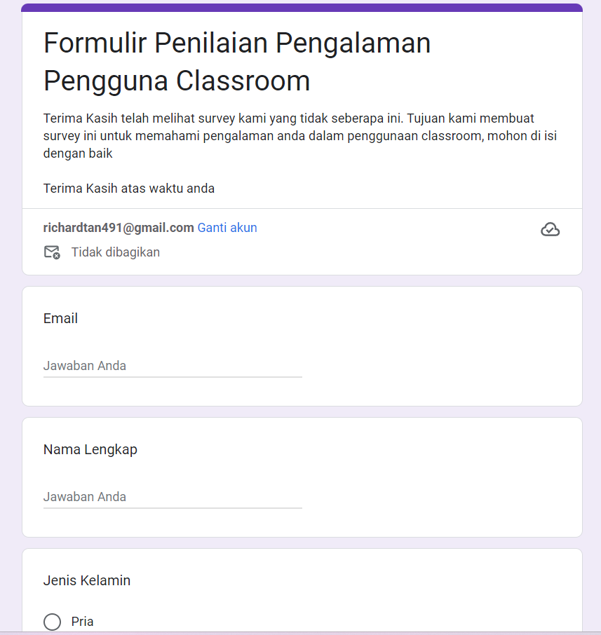
Revisi gform
Meeting 5 – Revisi Google Form 2

Slide 9
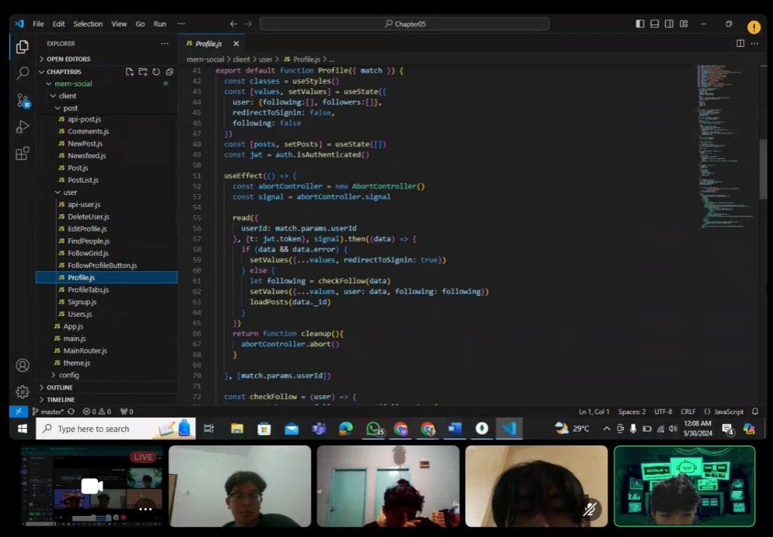
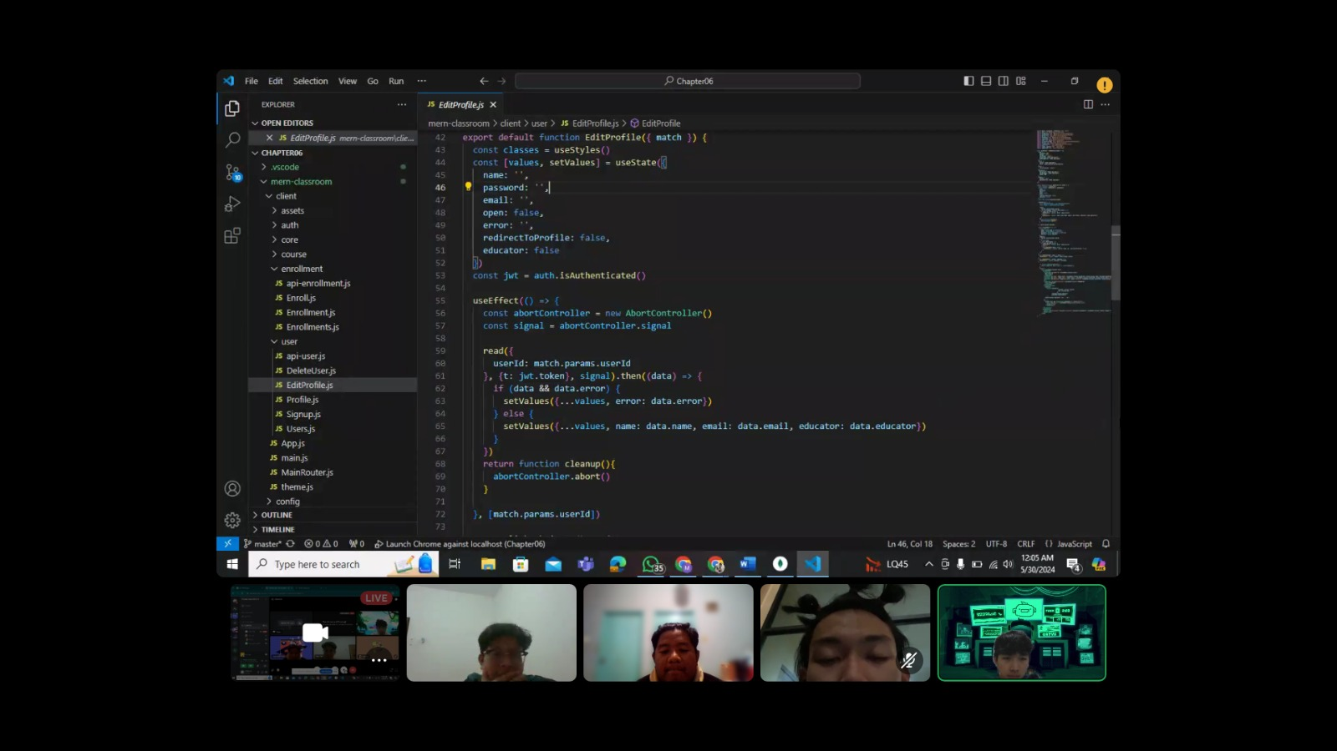
Hasil Laporan
Meeting 4 – Pembuatan App

Slide 10
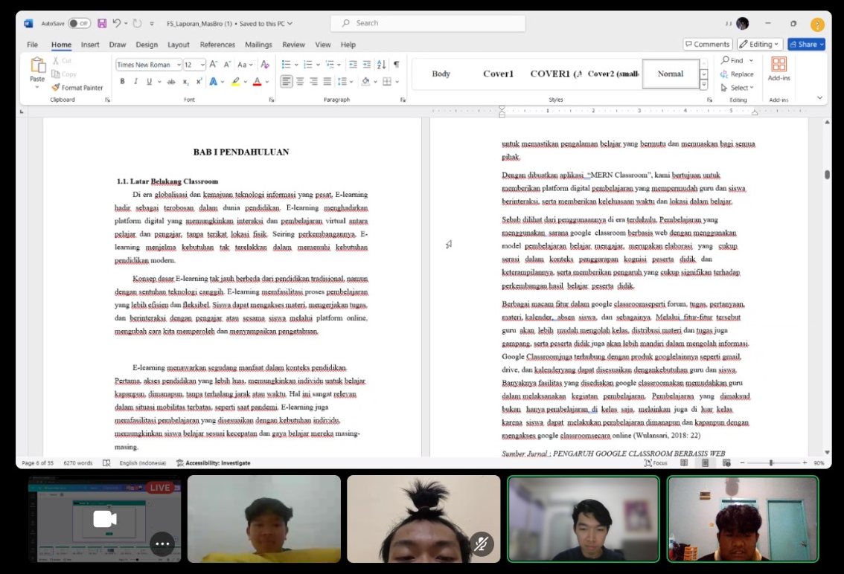
Hasil Laporan
Meeting 6 – Pembuatan Laporan

Slide 11
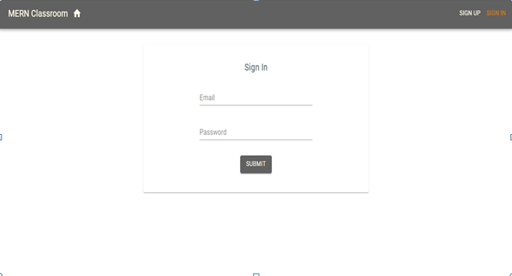
HASIL DESAIN Classroom
Halaman Sign In

Slide 12
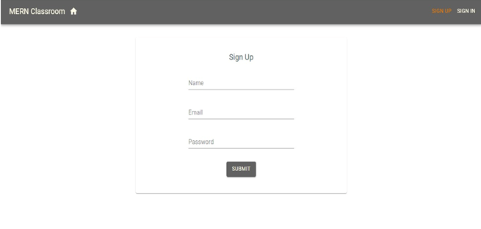
HASIL DESAIN CLAssroom
Halaman Sign up

Slide 13
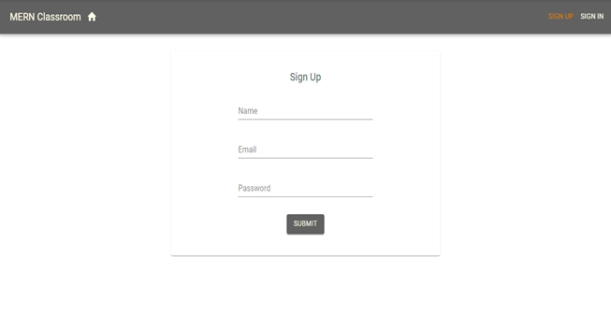
HASIL DESAIN classroom
Halaman DashBoard Student

Slide 14
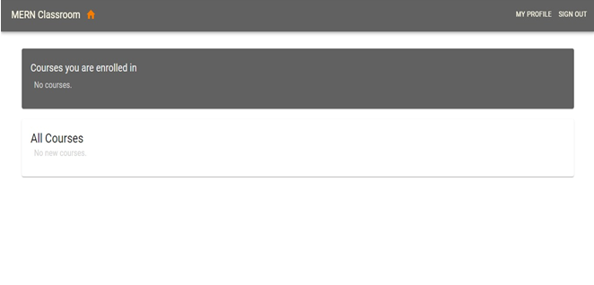
HASIL DESAIN classroom
Halaman DashBoard Student (setelah enrolment )

Slide 15
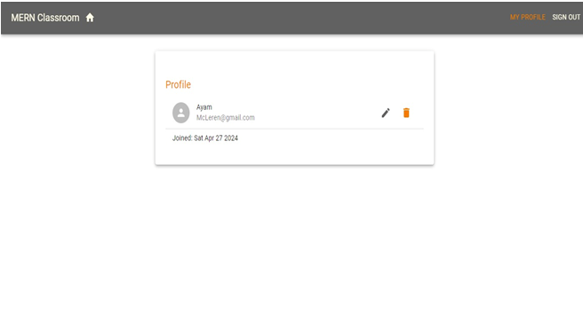
HASIL DESAIN classroom
Halaman Profile Pengguana

Slide 16
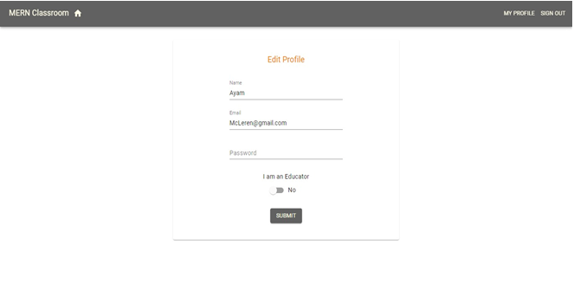
HASIL DESAIN classroom
Halaman Edit Profile (sebagai Student )

Slide 17
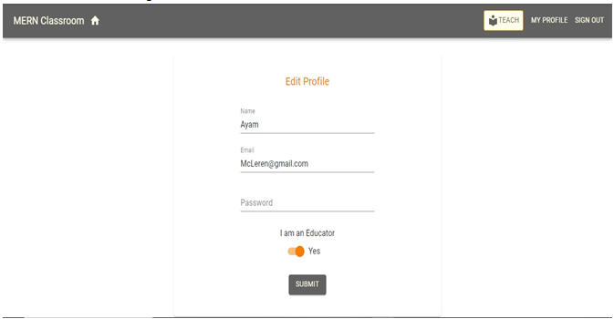
HASIL DESAIN classroom
Halaman Edit Profile (sebagai Educator )

Slide 18
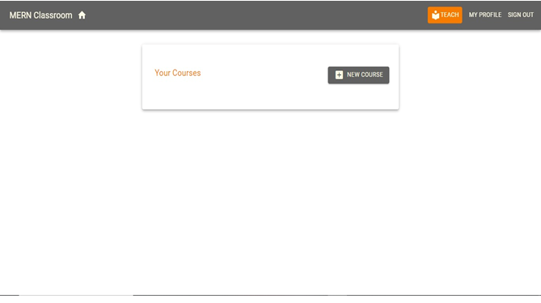
HASIL DESAIN classroom
Halaman Course

Slide 19
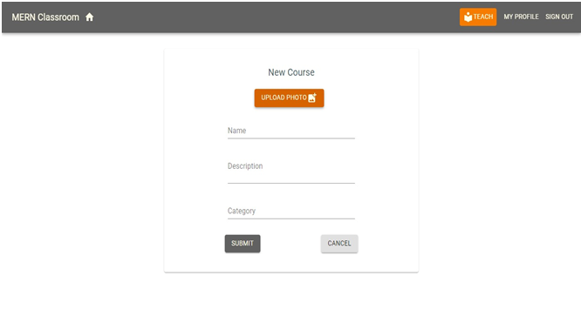
HASIL DESAIN classroom
Halaman add new Course

Slide 20
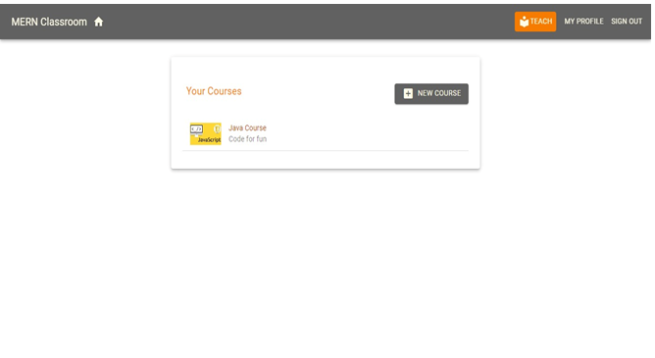
HASIL DESAIN classroom
Halaman Setelah add new Course

Slide 21
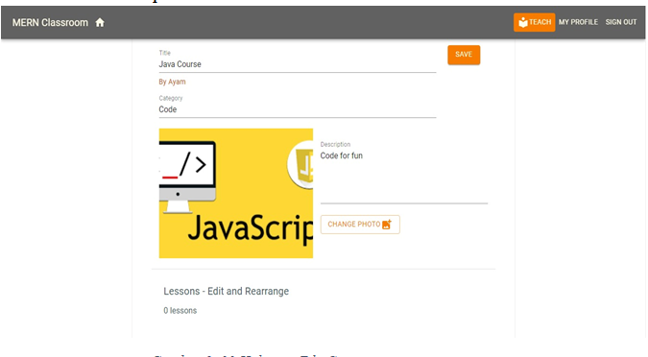
HASIL DESAIN classroom
Halaman Edit Course

Slide 22
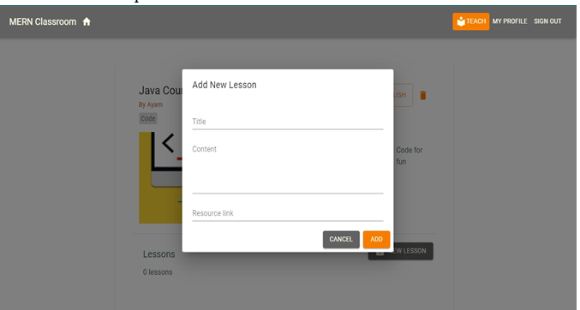
HASIL DESAIN classroom
Halaman Setelah add new Course

Slide 23
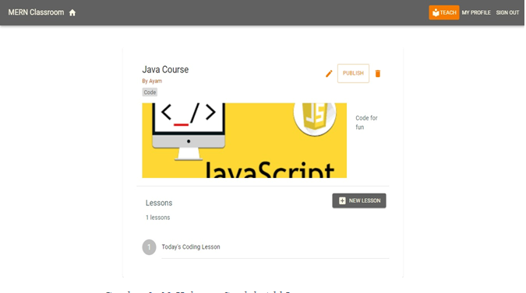
HASIL DESAIN classroom
Halaman Setelah add new Leson

Slide 24
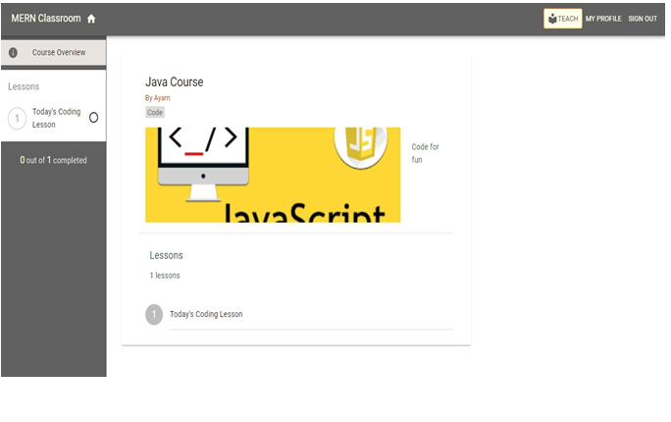
HASIL DESAIN classroom
Halaman Dalam Lesson

Slide 25
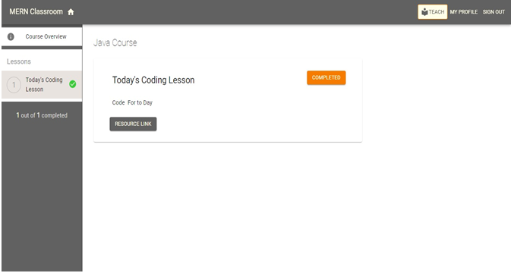
HASIL DESAIN classroom
Halaman Lesson diselesaikan

Slide 26
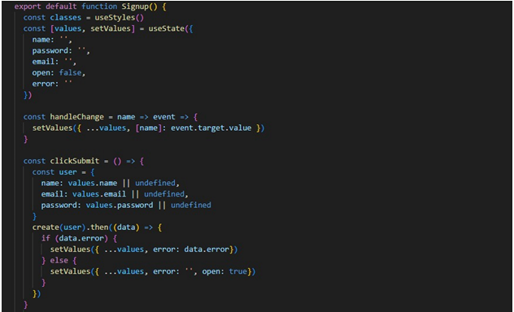
Coding Proyek classroom
Tampilan Coding Sign Up

Slide 27
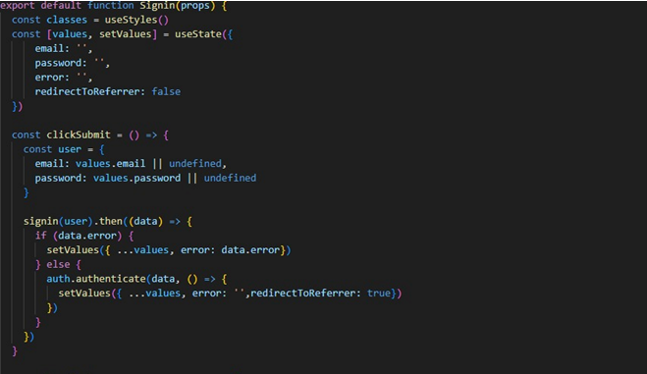
Coding Proyek classroom
Tampilan Coding Sign In

Slide 28
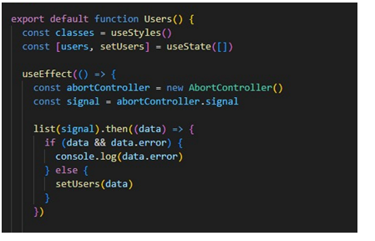
Coding Proyek classroom
Tampilan CodingUser

Slide 29
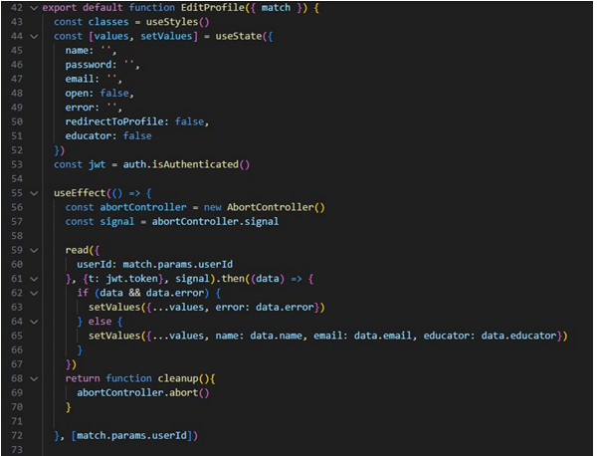
Coding Proyek classroom
Tampilan Coding Edit profile

Slide 30
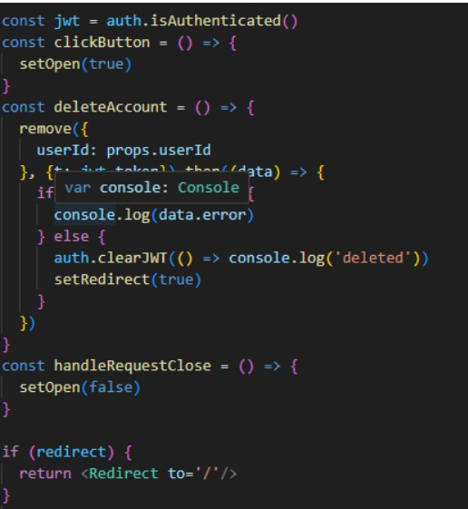
Coding Proyek classroom
Tampilan Coding Delete

Slide 31
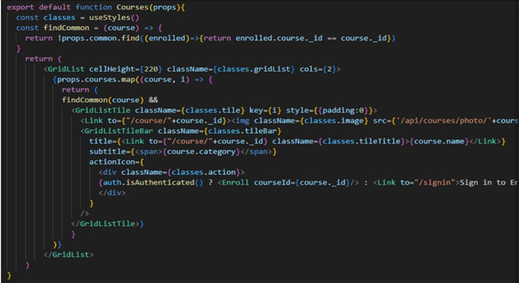
Coding Proyek classroom
Tampilan Coding Course

Slide 32
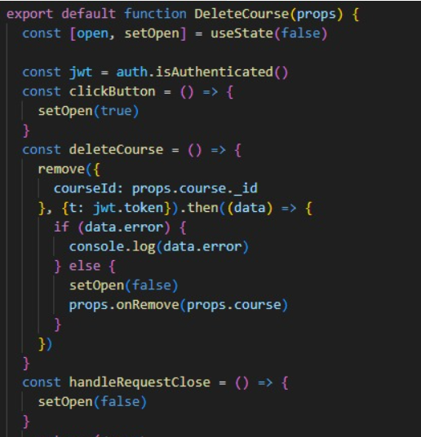
Coding Proyek classroom
Tampilan Coding Delete Course

Slide 33
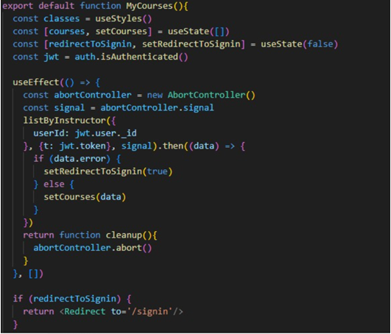
Coding Proyek classroom
Tampilan Coding My course

Slide 34
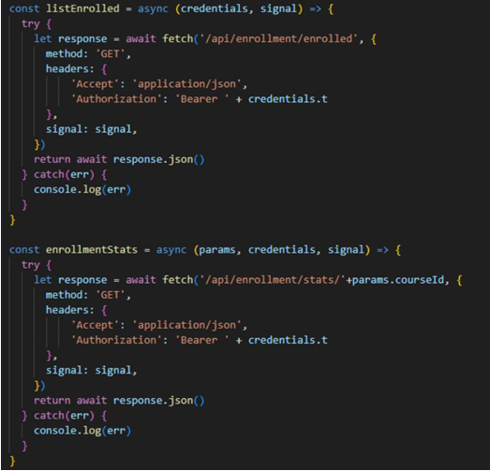
Coding Proyek classroom
Tampilan Coding API enrolment

Slide 35
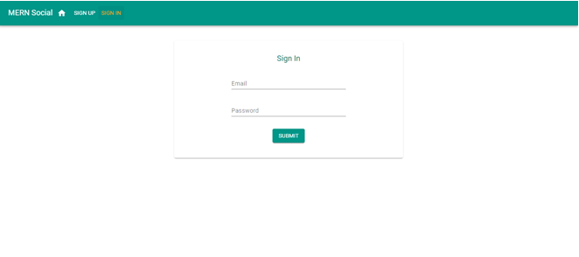
HASIL DESAIN Social media
Halaman Sign in

Slide 36
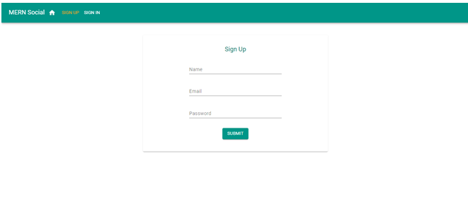
HASIL DESAIN Social media
Halaman Sign Up

Slide 37
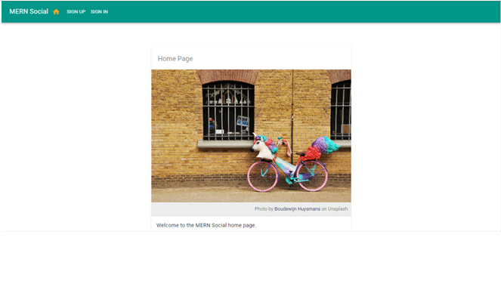
HASIL DESAIN Social media
Home Page awal

Slide 38
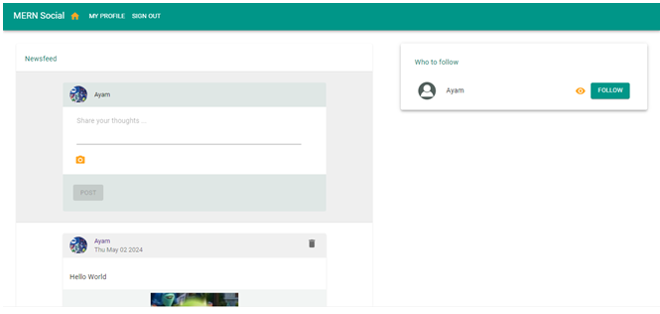
HASIL DESAIN Social media
Halaman Menu

Slide 39
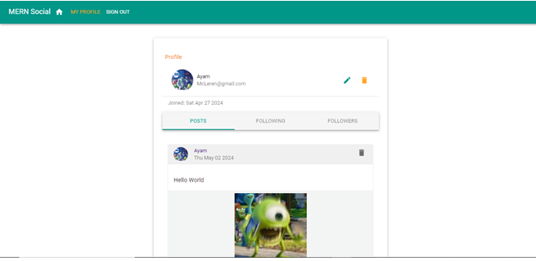
HASIL DESAIN Social media
Halaman Profil Pengguna

Slide 40
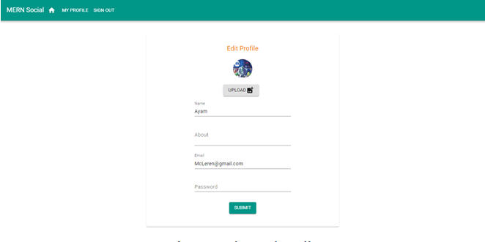
HASIL DESAIN Social media
Halaman edit profile

Slide 41
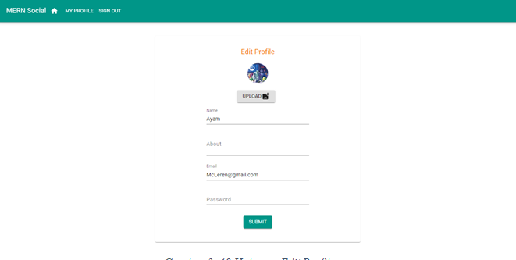
HASIL DESAIN Social media
Halaman edit profile

Slide 42
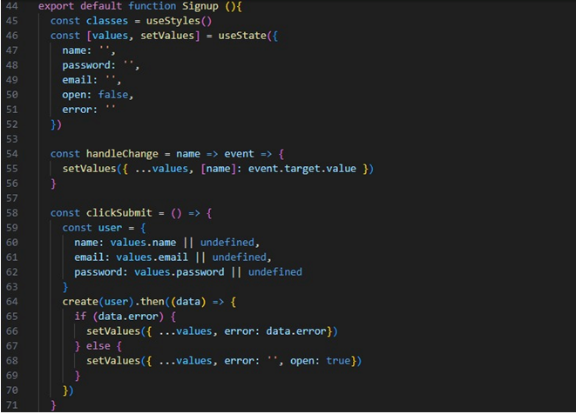
Coding Proyek Social Media
Tampilan Coding Sign Up

Slide 43
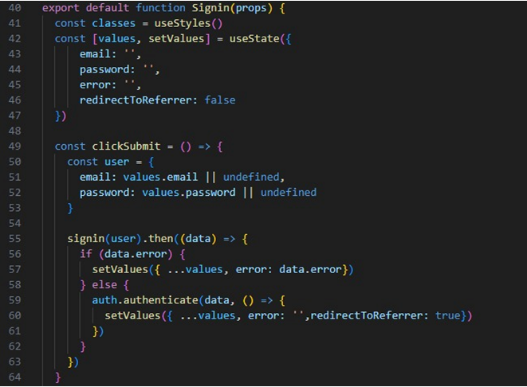
Coding Proyek Social Media
Tampilan Coding Sign in

Slide 44
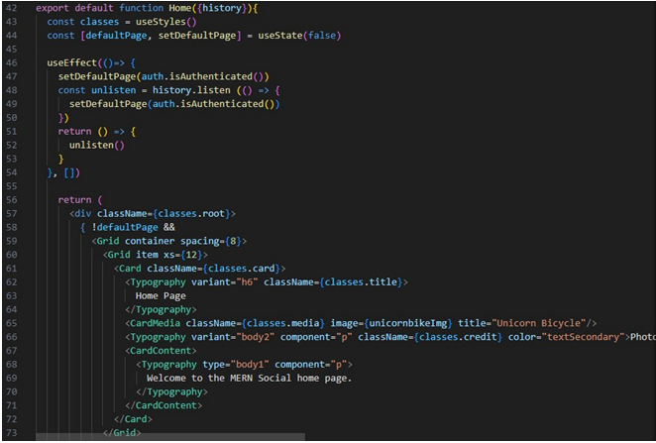
Coding Proyek Social Media
Tampilan Coding Home

Slide 45
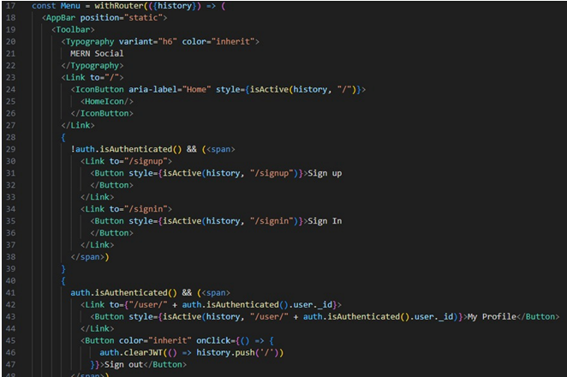
Coding Proyek Social Media
Tampilan Coding Menu

Slide 46
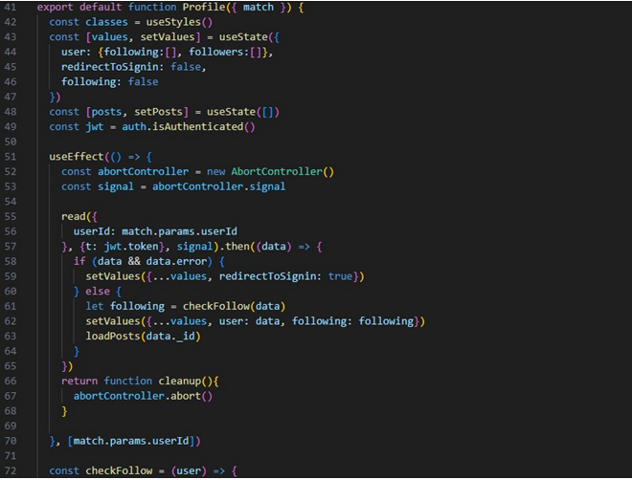
Coding Proyek Social Media
Tampilan Coding Profile

Slide 47
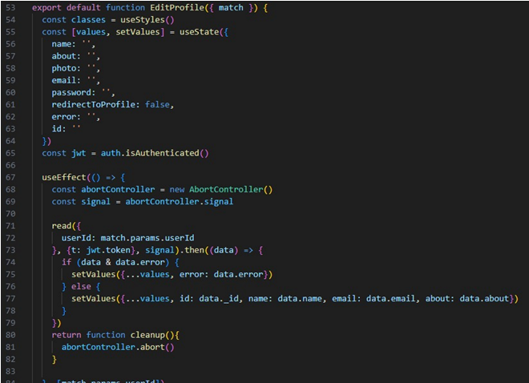
Coding Proyek Social Media
Tampilan Coding Edit profile

Slide 48
TERIMAKASIh

